Slide 1







PREPARE
Plan. Provision. Prioritize.

Slide 2
Private Citizens
Latest info
Peace of Mind
Fully Prepared

Slide 3
Agencies & NGOs
Reinforce evacuation orders
See where people are sheltered
Map of supplies
Enhance public engagement

Slide 4
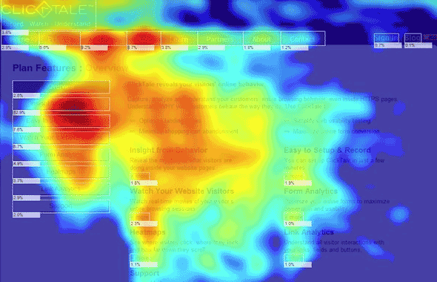
Private Shelters, Visualized

